Slide 1
Linear Regression
It all depends on line

Slide 2
Linear Regression
Introduction
Linear Regression
Linear Regression using stats model
Interpret Regression Model
Linear Regression (OLS) Assumptions
Linear Regression in R

Slide 3
Introduction

Slide 4
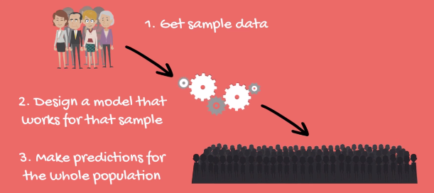
Linear Regression
“A linear regression is a linear approximation of a causal relationship between two or more variables”
The process goes like this:

Slide 5
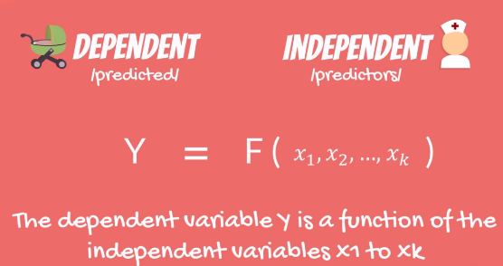
Linear Regression

Slide 6
Simple Linear Regression

Slide 7
Simple Linear Regression

Slide 8
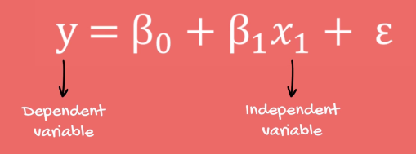
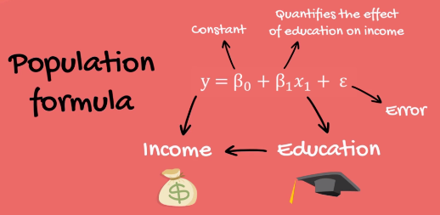
Simple Linear Regression

Slide 9
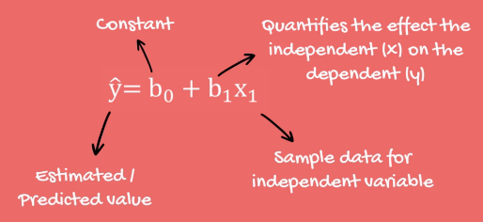
Simple Linear Regression Equation

Slide 10
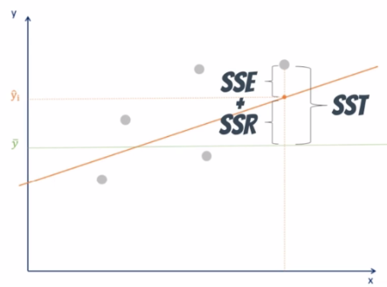
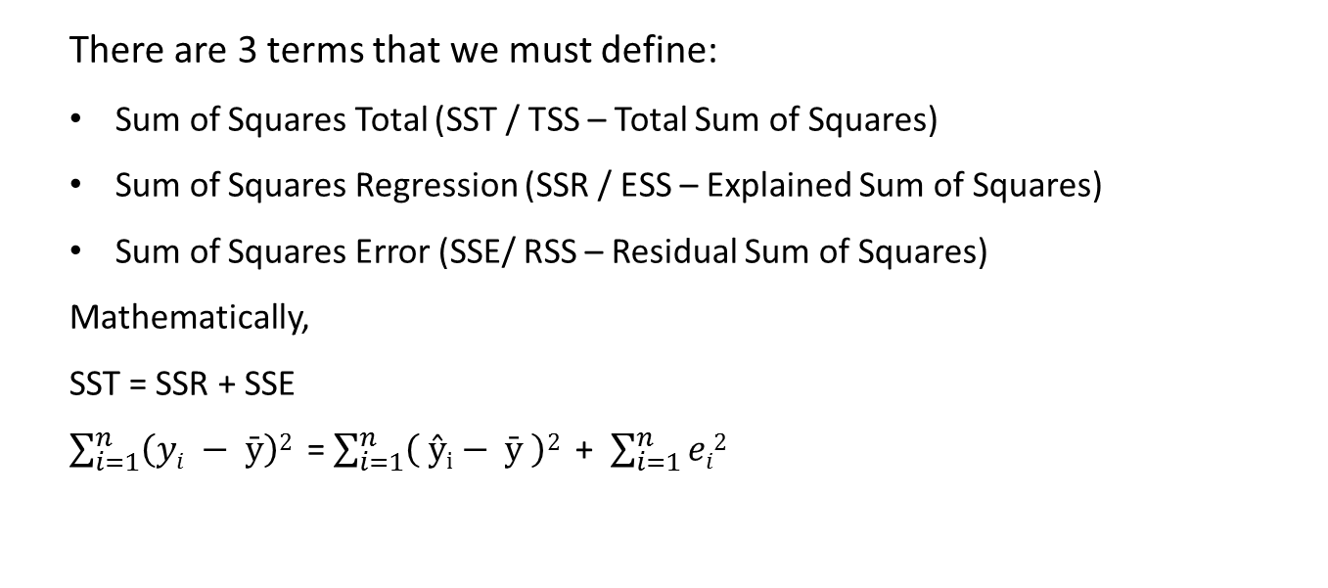
Simple Linear Regression Equation
There are 3 terms that we must define:
Sum of Squares Total (SST / TSS – Total Sum of Squares)
Sum of Squares Regression (SSR / ESS – Explained Sum of Squares)
Sum of Squares Error (SSE/ RSS – Residual Sum of Squares)
Mathematically,
SST = SSR + SSE
$\sum_{i=1}^{n}{\left(yi − \text{ȳ}\right)\text{2} }$ = $\sum_{i=1}^{n}{\left( \text{ŷ}\text{i}− \text{ȳ} \right)\text{2} }$ + $\sum_{i=1}^{n}{ei\text{2} }$

Slide 11
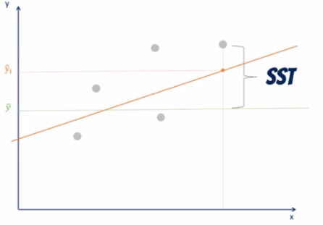
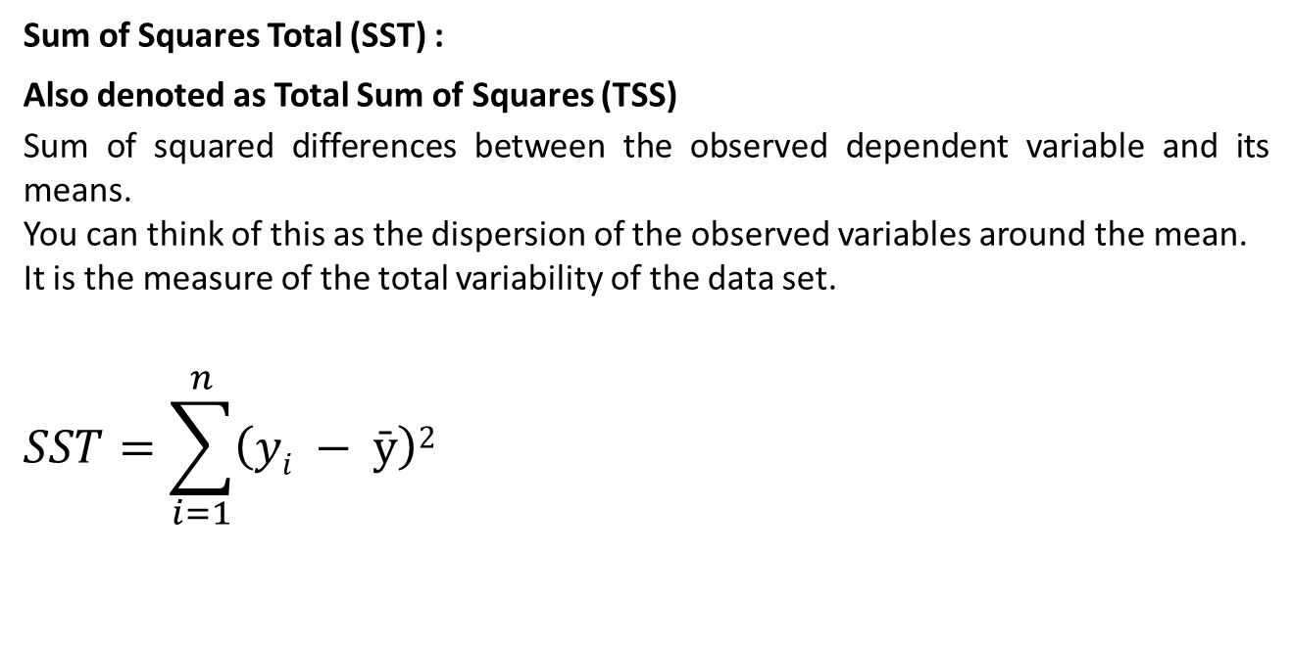
Simple Linear Regression Equation
Sum of Squares Total (SST) :
Also denoted as Total Sum of Squares (TSS)
Sum of squared differences between the observed dependent variable and its means.
You can think of this as the dispersion of the observed variables around the mean.
It is the measure of the total variability of the data set.
$$SST=\sum_{i=1}^{n}{\left(yi − \text{ȳ}\right)\text{2} }$$

Slide 12
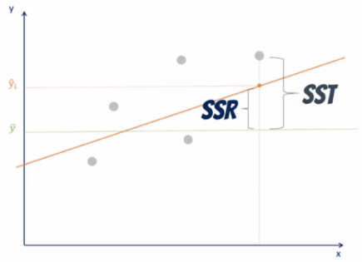
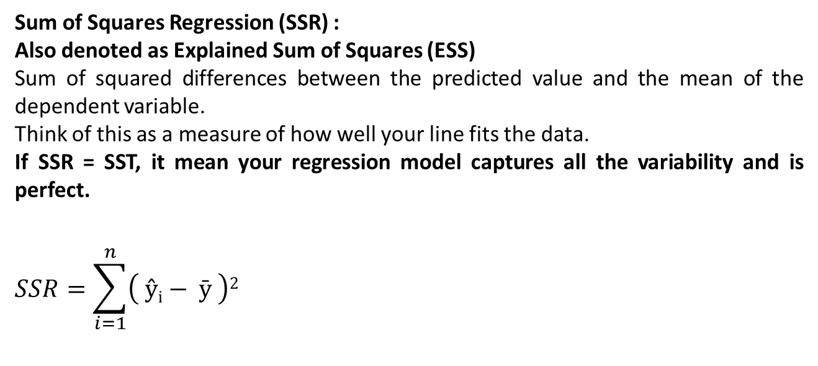
Simple Linear Regression Equation
Sum of Squares Regression (SSR) :
Also denoted as Explained Sum of Squares (ESS)
Sum of squared differences between the predicted value and the mean of the dependent variable.
Think of this as a measure of how well your line fits the data.
If SSR = SST, it mean your regression model captures all the variability and is perfect.
$$SSR=\sum_{i=1}^{n}{\left( \text{ŷ}\text{i}− \text{ȳ} \right)\text{2} }$$

Slide 13
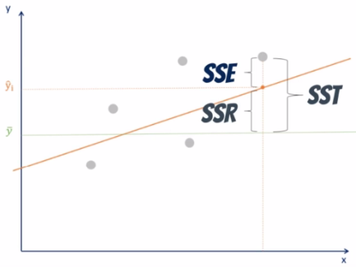
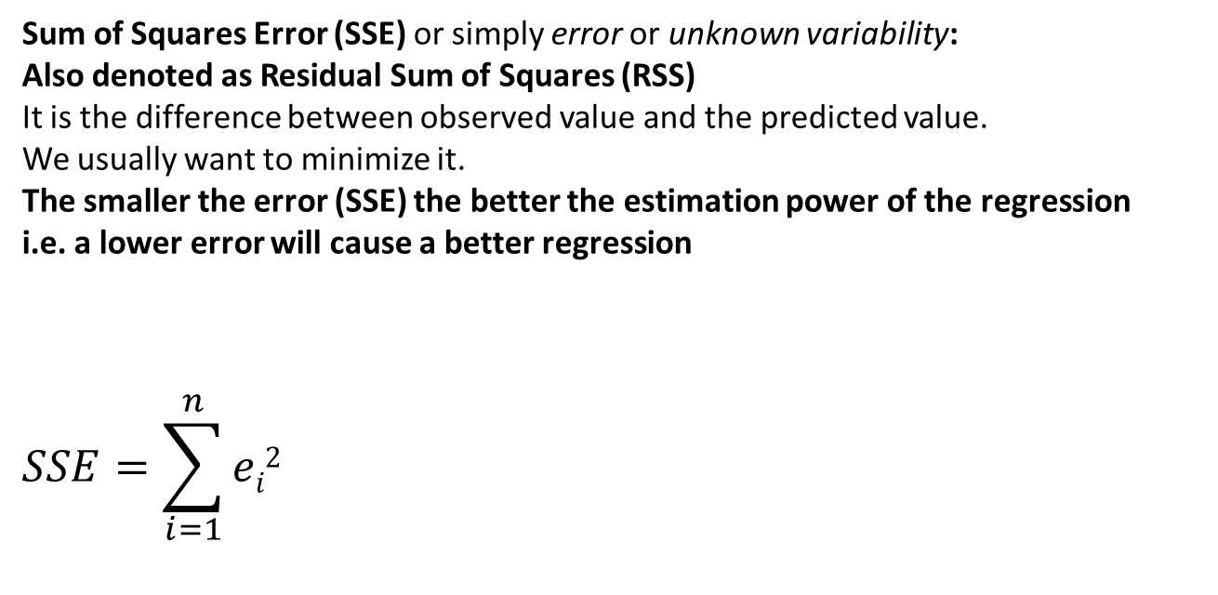
Simple Linear Regression Equation
Sum of Squares Error (SSE) or simply error or unknown variability:
Also denoted as Residual Sum of Squares (RSS)
It is the difference between observed value and the predicted value.
We usually want to minimize it.
The smaller the error (SSE) the better the estimation power of the regression
i.e. a lower error will cause a better regression
$$SSE=\sum_{i=1}^{n}{ei\text{2} }$$

Slide 14
Correlation Vs Regression

Slide 15
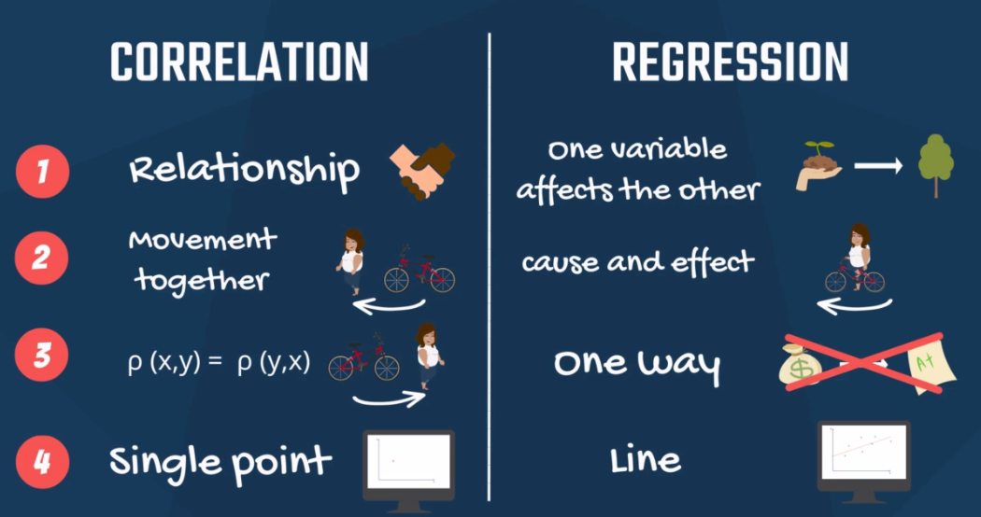
Linear Regression Vs Correlation

Slide 16
Linear Regression Vs Correlation
Correlation is the measure of linear relationship between two variables.
Correlation does not imply causation.
Regression analysis is the tool to model the linear relationship between two variables.
It tells to what degrees approximately the independent variable affects the dependent
Regression analysis is useful when there is strong positive or negative
correlation between two variables.
Poor correlation between two variables does not implies independency
of two variables. There may be non-linear relationship between given
two variables.

Slide 17
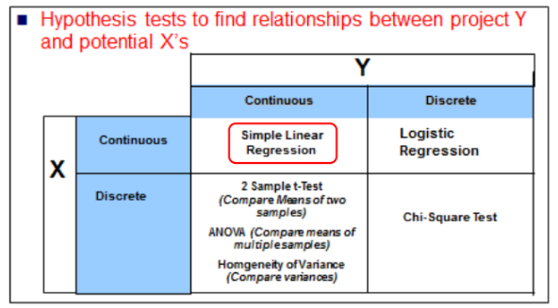
When to use Linear Regression ?
Select A Statistical Test
E.g: We used ANOVA with the plant food example, where X was discrete with number of feedings per day (one or two) while Y was the plant height which was continuous

Slide 18
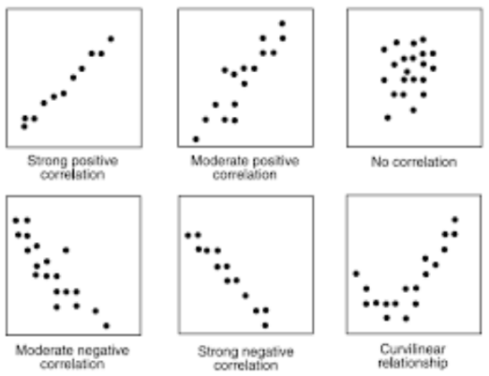
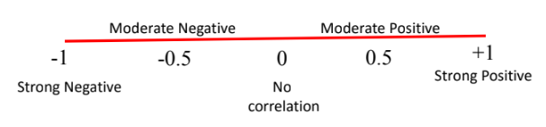
When to use Correlation ?
When variables under consideration are continuous and you want to check
whether there is any linear relationship between variables (more than 2 variables) under consideration.
When you want to check whether the observed correlation is significant or
not.

Slide 19
Correlation with R
> cor(x,y)
[1] -0.7761684
> cor.test(x,y)
Pearson's product-moment correlation
data: x and y
t = -6.7424, df = 30, p-value = 1.788e-07
alternative hypothesis: true correlation is not equal to 0
95 percent confidence interval:
-0.8852686 -0.5860994
sample estimates:
cor
-0.7761684

Slide 20
Simple Linear Regression with Python
statsmodels

Slide 21

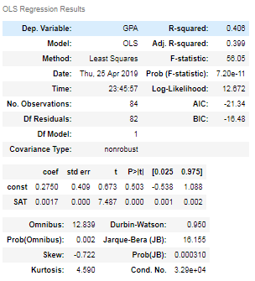

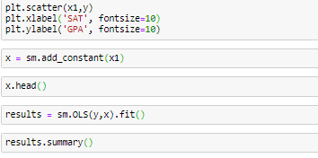

Linear Regression with Python - statsmodels

Slide 22
Linear Regression with Python - statsmodels
Interpreting the Regression Table
Coefficients Table: To obtain the regression equation
Looking at the coefficients table:
Coefficient of constant (b0) = 0.2750
Coefficient of SAT (b1) = 0.0017
Hence the equation of line: y = b₀ + b1 * x1
y = 0.275 + 0.0017 * x1 i.e.
GPA = 0.275 + 0.0017 * SAT
Std err: The standard error shows the accuracy of prediction for each variable. The lower the standard error better the estimate
t statistics and P value: There is a hypothesis involved here
Null hypothesis is H₀: β = 0 (Coefficient = zero, i.e. variable not significant)
Basically the hypothesis asks Is this a useful variable ?
If p-value < 0.05, we reject null hypothesis – i.e. variable are significant

Slide 23
Linear Regression with Python - statsmodels
Interpreting the Regression Table
2. Model Summary Table:
Looking at the model summary table:
Dep Variable: Variable we are trying to predict
Model: Which model/approach is used for regression. Here OLS or Ordinary Least Squares
OLS is the most common method for linear regression. Least Squares stands for the minimum squares error or SSE.
Hence this method aims to find the line, which minimizes the SSE.
Other Models which can be used are:
Generalized Least Squares
Maximum Likelihood Estimation
Bayesian Regression
Kernel Regression
Gaussian Process Regression
Method: The method used within the Model. Here Least Squares

Slide 24
Linear Regression with Python - statsmodels
Interpreting the Regression Table
2. Model Summary Table:
Looking at the model summary table:
R-squared: measures the goodness of fit of your model. More factors (variables) we include in Regression, the higher the R-squared
This is a relative measure and takes values ranging from 0 to 1
R² = 0 , Regression Line explains no variability of data
R² = 1 , Regression Line explains entire variability of data
Usually you get values between 0.2 – 0.9
This is the ratio of SSR to SSE (SSR / SSE)
There is no such thing called as a good value of R2. It is relative.
In Science or Physics or Mathematics usually 0.7 or higher is a good value.
In Social Science a value of 0.2 or 0.3 could be fantastic.
It depends on the problem and number of variables involved.
e.g. your salary. It depends on education, your experience, place of living, languages you speak etc. However, it is quite possible that all of these in total contribute less than 40% of the variability of your salary.

Slide 25
Linear Regression with Python - statsmodels
Interpreting the Regression Table
2. Model Summary Table:
Looking at the model summary table:
R-squared:
Here in our model, the R-squared value is 0.406 ~ 0.41.
In other words, SAT explains the 41% variability of the college GPA for our sample
Now this value is neither good nor bad, but 41% denotes that probably we may be missing some information, say, like gender, attendance, student working or not, marital status etc.

Slide 26
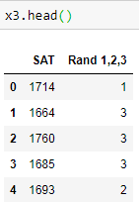
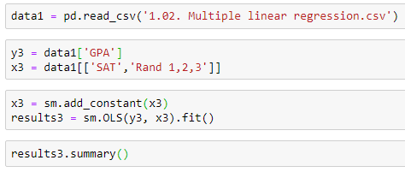
Linear Regression with Python - statsmodels
Interpreting the Regression Table
2. Model Summary Table:
Looking at the model summary table:
Adj. R-squared: This is smaller than the R-square as it penalizes the excessive use of additional variables added to the model which are not significant.
Lets, see how it penalizes the use of variables that are not significant
So we use a new dataset, which simply contains a new variable added to the college GPA dataset. The column added is a number assigned to each student at random which is not significant.

Slide 27


Linear Regression with Python - statsmodels
Interpreting the Regression Table
2. Model Summary Table:
Looking at the model summary table:
Adj. R-squared:
Without New Variable
With New Variable
Although the R-squared value has gone up, which it should as it expects each new variable to increase the explanatory power of the Regression,
The Adjusted R – Squared value does down to 0.392.
The model has been penalized for adding additional variable that has no strong explanatory power. We have added information to the model, but have lost the value.

Slide 28
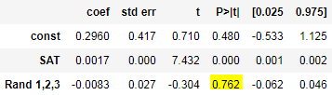
Linear Regression with Python - statsmodels
Interpreting the Regression Table
2. Model Summary Table:
Looking at the model summary table:
Adj. R-squared:
Also the Regression analysis in itself is smart. It does point out when we add an impractical variable. Check out the coefficients table p-value for the new variable.
The p-value is greater than 0.05, which simply means the null hypothesis upholds
i.e. the variable is of no significant importance.
Conclusion: The variable Rand 1,2,3 has not only worsen the explanatory power of the model (Reflected by lower Adjusted R-square) but is also insignificant. Hence it should be dropped altogether.

Slide 29
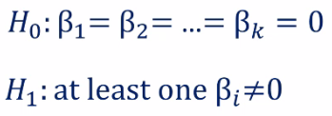
Linear Regression with Python - statsmodels
Interpreting the Regression Table
2. Model Summary Table:
Looking at the model summary table:
F-statistic: Used to get the overall significance of the model
It follows the f-distribution
Lower the F-statistics, closer to non-significant model
The hypothesis formulated in this case is:
If all betas are zero, then none of the x (variables) matter => our model has no merit
Lets compare the F-statistics of our old model vs the new model with a new variable

Slide 30


Linear Regression with Python - statsmodels
Interpreting the Regression Table
2. Model Summary Table:
Looking at the model summary table:
F-statistic: Used to get the overall significance of the model
Old Model
New Model
F-statistics = 56.05
p-value = 7.20e-11 ~ 0.000
which says that the overall model is significant
F-statistics = 27.76
p-value = 6.58e-10 ~ 0.000
F-statistics is lower, the model is still significant but less than the old one.
Lower the F-statistic, closer to a non-significant model

Slide 31
Multiple Linear Regression with Python
statsmodels

Slide 32
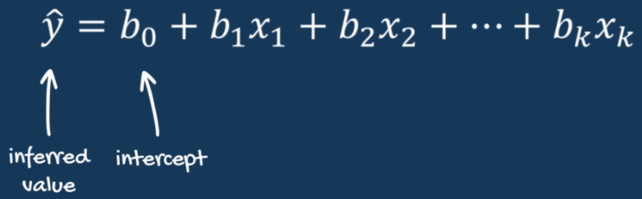
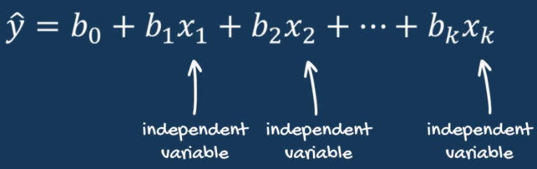
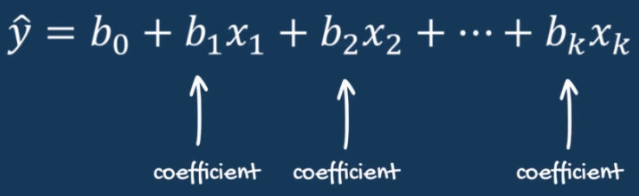
Linear Regression with Python
The multiple regression is not about the best fitting line anymore. It is about the best fitting model.
It stops being two dimensional and when we have more than three dimensions (variables), there is no visual way to represent the data.
As we saw from OLS, what we really want is the least SSE. And how do we decrease SSE ?
By increasing the explanatory power of the model, which can be done by including more variables.
More variables usually result in better fitting model. However, this is not always true. We shall see that case as well.

Slide 33
Linear Regression Expected Values
Sr. No | Statistics | Expected Value
1 | P > |t| (p-value) | < 0.05 (then variable is significant)
2 | Std err | The lower the better
3 | R-squared | 1 is the best (Usually ranges between 0.2 -0.9) 0 -> model explains no variability 1 -> model explains entire variability
4 | Adjusted R-squared | More towards 1, the better it is
5 | F-statistics | Higher the better
6 | Prob (F-statistic) | < 0.05, model is significant
7 | Omnibus | Value close to 0 (indicates Normalcy)
8 | Prob(Omnibus) | Value close to 1
9 | Skew | Value close to 0 (indicates Normalcy)
10 | Kurtosis | Value = 3, ideally indicates Normalcy Ranges from 1 to infinity
11 | Durbin – Watson | Value between 1 to 2
12 | Prob (JB) | < 0.05 , Reject Null, Data not normally distributed > 0.05, Fail to Reject Null, Data Normalcy
13 | Condition Number | Value less than 30

Slide 34
So Far…

Slide 35
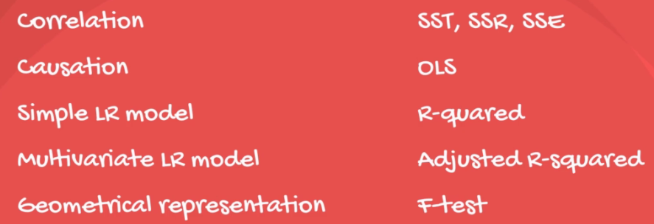
Summary so far…

Slide 36
Linear Regression (OLS) Assumptions

Slide 37
Linear Regression (OLS) Assumptions
There are 5 assumptions for OLS:
Linearity: Linear Regression is the simplest regression and it assumes linearity among the variable(s)
No endogeneity: Omitted Variable bias
Normality & Homoscedasticity of error term: The error term is normally distributed . Homoscedasticity mean constant variance.
No autocorrelation: The co-variance of any two error terms is zero. This is the assumption that usually stops us from using a linear regression in our analysis.
No multi-collinearity: Multi-collinearity It is observed when two or more variables have a high correlation between each other.

Slide 38
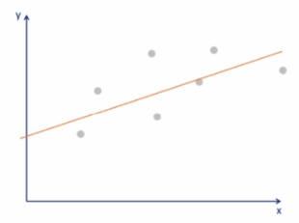
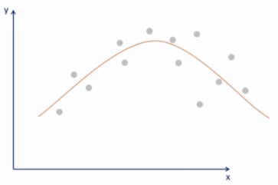
Linear Regression (OLS) Assumptions
Linearity: Variables should be linearly dependent with each other
The easiest way is to take the independent variable(s) x_{i} one at a time and plot it against the dependent variable y on a scatter plot.
If the data points form any straight line pattern then the linear regression is suitable for those variables.
For Non-linear variables, either you can use the non-linear regression or you can transform your relationship to linear and then use it.
For transformation you can use:
Exponential Transformation
Log Transformation

Slide 39
Linear Regression (OLS) Assumptions
No endogeneity: It is related to the problem of ‘Omitted Variable bias
Basically, it is very well possible that all your included variables do not explain the variability of the regression model. You might have missed to include the relevant variable in the model, which leads to incorrect and bias results.
Possibly, your dependent variable y, may be correlated with the missed variable and hence causing the pains with your model.
However, caution is advised to tackle Omitted variable bias as incorrect inclusion of variables leads to inefficient estimated/models.
So when in doubt, just include the variables and try your luck.

Slide 40
Linear Regression (OLS) Assumptions
Normality & Homoscedasticity:
It comprises of three parts (all for error term):
Normality
Zero Mean
Homoscedasticity
Normality: Error term is normally distributed. Note that normal distribution is not required for creating the regression but for making inferences.
Remember the regression table with t-statistics and F-statistics, well all those works because we assume normality of the error term.
What should we do if error term is not normally distributed ?
The Central Limit Theorem. For large samples the CLT applies for error term too. Hence we can consider normality as a given for us.

Slide 41
Linear Regression (OLS) Assumptions
Normality & Homoscedasticity:
It comprises of three parts (all for error term):
Normality
Zero Mean
Homoscedasticity
Zero Mean: If the mean is not expected to be 0 then the line is not the best fitting one. However, having an intercept solves that problem.
Hence in real life, it is unusual to violate this part of the assumption.
Homoscedasticity: It means to have equal variance. Basically the error terms should have equal variance one with the other.
If there is heteroscedasticity in the error term, then look for:
Omitted Variable Bias
Outliers
Log Transformation

Slide 42


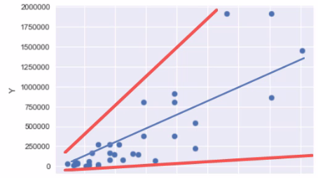
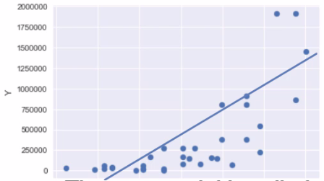
Linear Regression (OLS) Assumptions
Normality & Homoscedasticity:
Log Transformation….
Do natural log transformation of each dependent variable in Y
Then create regression of that log(y) and the independent Xs
Conversely, you can take log of independent X that is causing the trouble and do the same.
Heteroscedasticity increases from left to right
Heteroscedasticity controlled
Semi-log model

Slide 43
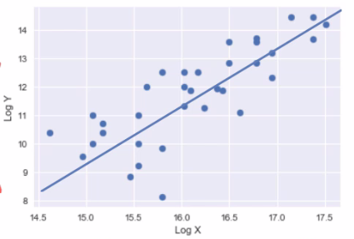
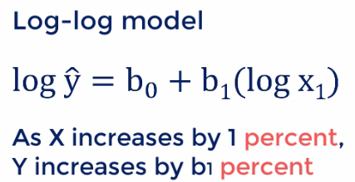
Linear Regression (OLS) Assumptions
Normality & Homoscedasticity:
Log Transformation….
Or you can do the log transformation for both dependent and independent variables and create regression on that.
This relationship is known as elasticity

Slide 44
Linear Regression (OLS) Assumptions
No auto-correlation: also known as no serial correlation
This cannot be relaxed.
Errors are assumed to be un-correlated.
i.e. it assumes the errors should be randomly spread around the regression line.
It is highly unlikely to find serial correlation between errors take at one moment of time, known as cross-sectional data.
However, it is very common in time series data. Think about the stock prices. Every day you have a new quote price for the same stock. Which shows that the errors are not auto-correlated that is errors are randomly spread across the and hence you cannot predict the stock prices.

Slide 45
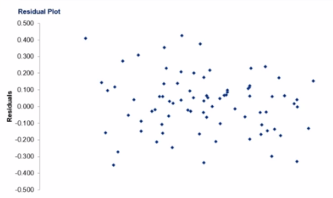
Linear Regression (OLS) Assumptions
No auto-correlation: also known as no serial correlation
This cannot be relaxed.
How to look for auto-correlation ?
Common way is to plot all the residuals on a graph and try to find a pattern. If you cannot find any, you are safe.

Slide 46
Linear Regression (OLS) Assumptions
No auto-correlation: also known as no serial correlation
This cannot be relaxed.
How to look for auto-correlation ?
Another way is Durbin-Watson test, which is there in the regression table summary
Generally its values lie between 0 and 4
Value = 2 : no auto-correlation
Value < 1 or value >3 : Cause for alarm, looks like auto-correlation
There is no remedy for this problem. The only thing you can do here is you can avoid using the linear regression in this case.
You may use other models such as Autoregressive model, Moving average model, Autoregressive Moving Average Model, Autoregressive Integrated Moving Average Model

Slide 47
Linear Regression (OLS) Assumptions
No multi-collinearity: We observer multi-collinearity when two or more variables have a high correlation
The reason for this assumption is, in multi-collinearity, the relationship is symmetric. Hence the variability of one can be represented by the other. In such cases, there is no need to include both the variables, we can keep any one of them.
Fixes: There are 3 ways to do this
You can drop one of the two variables
You can transform them into one variable
You can keep them both and treat them with extreme caution

Slide 48
Linear Regression with R
> summary(Z)
Call:
lm(formula = y ~ x)
Residuals:
Min 1Q Median 3Q Max
-59.26 -28.93 -13.45 25.65 143.36
Coefficients:
Estimate Std. Error t value Pr(>|t|)
(Intercept) 324.08 27.43 11.813 8.25e-13 ***
x -8.83 1.31 -6.742 1.79e-07 ***
---
Signif. codes: 0 ‘***’ 0.001 ‘**’ 0.01 ‘*’ 0.05 ‘.’ 0.1 ‘ ’ 1
Residual standard error: 43.95 on 30 degrees of freedom
Multiple R-squared: 0.6024, Adjusted R-squared: 0.5892
F-statistic: 45.46 on 1 and 30 DF, p-value: 1.788e-07
> Z <- lm(y ~ x)
> Z
Call:
lm(formula = y ~ x)
Coefficients:
(Intercept) x
324.08 -8.83

Slide 49
Approaches of Linear Regression

Slide 50
Approaches of Linear Regression
Popular methods of building models:
All in
Backward Elimination
Forward Selection
Bidirectional Elimination
Score Comparison
Note: Backward, Forward and Bi-direction are called as Stepwise Regression. However, sometimes, if we refer Stepwise Regression, generally Bi-directional Elimination is considered

Slide 51

Approaches of Linear Regression
“All – in” – cases:
Prior knowledge of features that all features are important
Or you have to put all features into modelling
Or you are preparing for Backward Elimination

Slide 52
Approaches of Linear Regression
Backward Elimination:
Step 1: Select a significance level to stay in the model (e.g. SL = 0.05)
Step 2: Fit the full model with all possible predictors (All-in approach)
Step 3: Consider the predictor with highest p-value (Basically check for non-significant features/predictors)
If p-value > SL, proceed to Step 4, else FINISH
Step 4: Remove the predictor/feature/variable with highest p-value
Step 5: Fit model without this variable(s).

Slide 53
Approaches of Linear Regression
Forward Selection:
Step 1: Select a significance level to stay in the model (e.g. SL = 0.05)
Step 2: Fit all simple regression models (y ~ x_{n} ).
Select the one with the lowest p-value
Step 3: Keep this variable and fit all possible models with one extra predictor added to the one(s) you already have.
Step 4: Consider the predictor with the lowest p-value.
If p < SL, go to Step 3, otherwise FINISH.

Slide 54
Approaches of Linear Regression
Bi-direction Elimination: (combines Forward and Backward)
Step 1: Select a significance level to enter and to stay in the model
(e.g. SL-Enter = 0.05, SL-Stay = 0.05)
Step 2: Perform the next step of forward selection (new variables must have p-value < SL-Enter to enter). Basically add a new variable based on forward selection method.
Step 3: Perform all steps of backward elimination (old variables must have p-values < SL-Stay to stay)
Step 4: No new variables can enter and variables can exit, then FINISH

Slide 55
Approaches of Linear Regression
Score Comparison:
Step 1: Select a criterion (score) of goodness of fit (e.g. R2 or adjusted R2)
Step 2: Construct All Possible Regression Models 2^{N}-1 total combinations (if you have n features, you create 2^{N}-1 models)
Step 3: Select the one with the best criterion/score
Step 4: FINISH
This sounds easy but even if you have 10 columns in your dataset, you create 1023 models. That is very resource intensive. This is usually not preferred.

Slide 56
Thank You

